Slide 1




PLUGSi

Slide 2

SMART
MODULAR
POWER OUTLET

Slide 3




Slide 4
ATTACH
DETACH
REATTACH

Slide 5
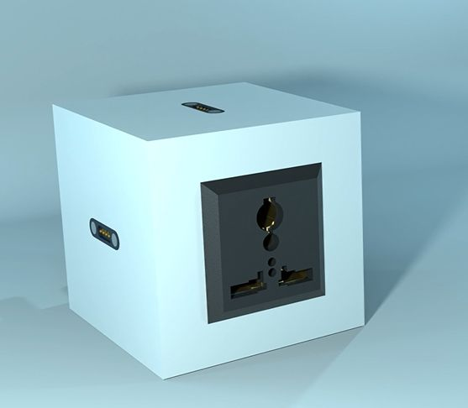

The Device Consists of Two Main Parts
Power Base
Modules

Slide 6
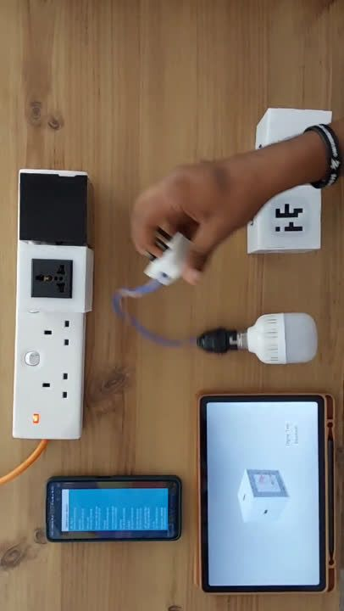
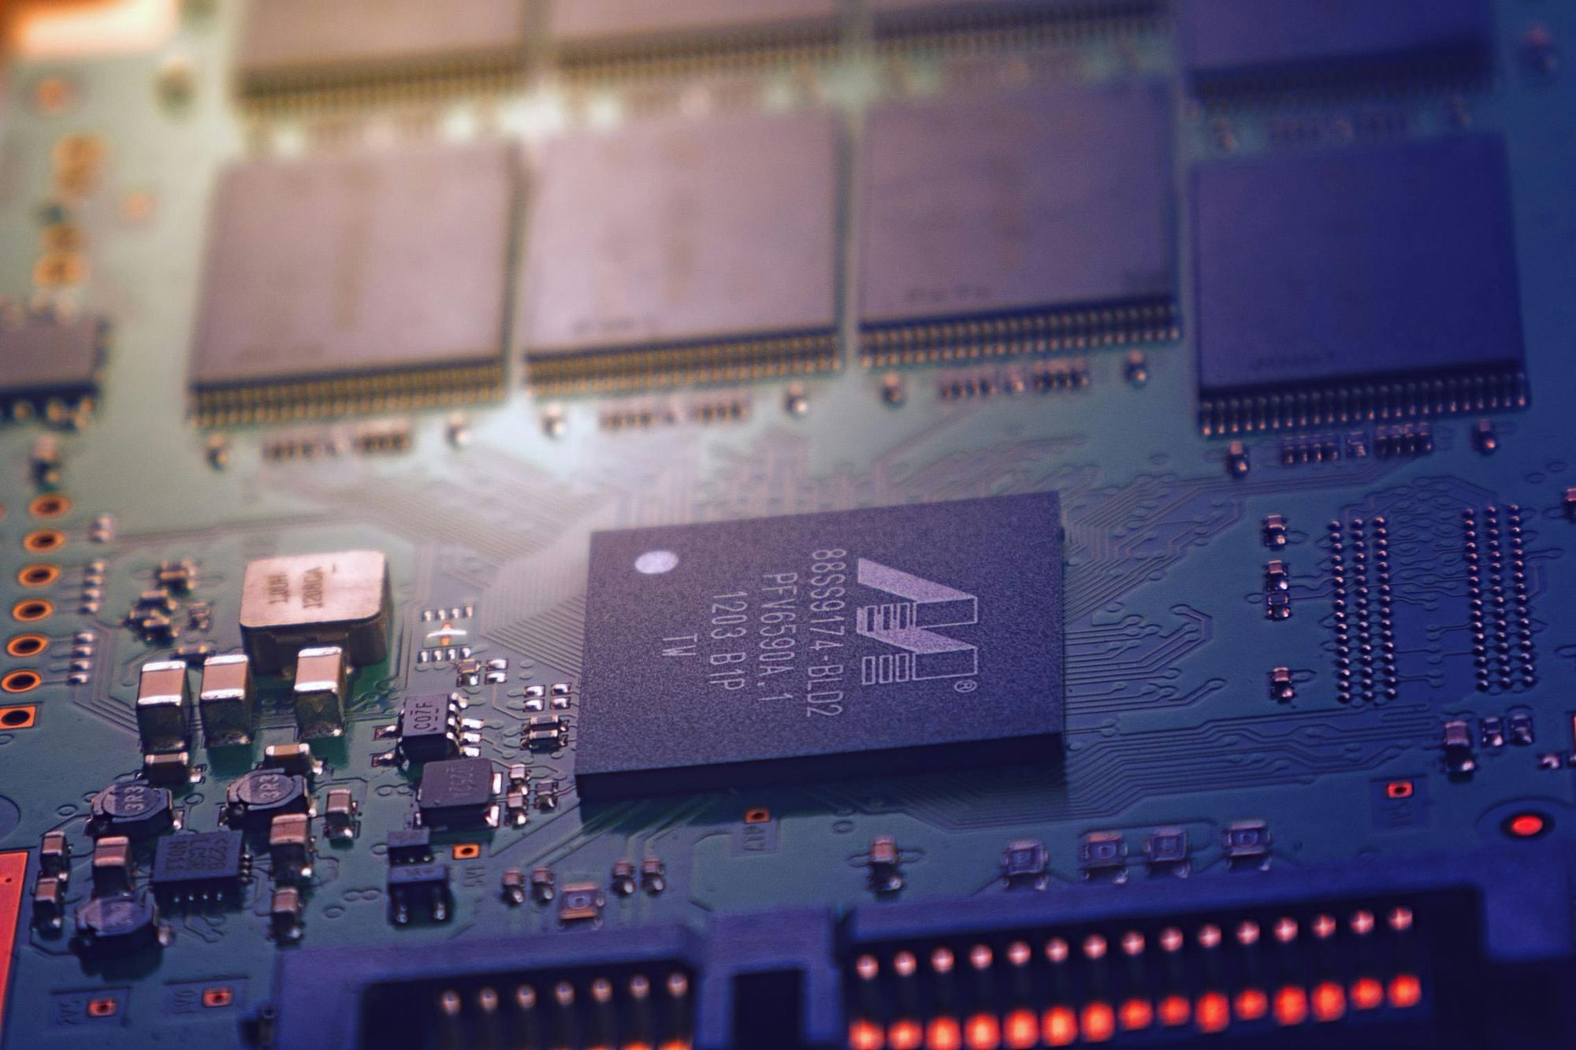

Slide 7
Market Analysis and Business Plan

Slide 8
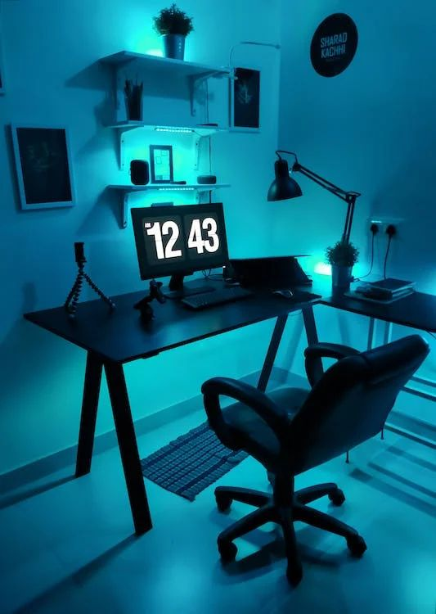
What is our Target Market?
Consumer

Slide 9
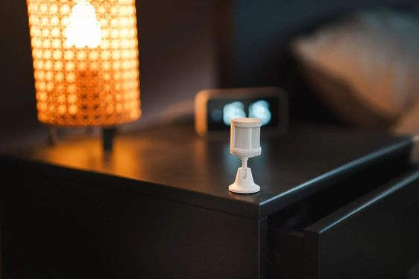



Our Target Market expects
IoT Adoption
Reasonable Pricing
Customization and Flexibility
Energy Efficiency

Slide 10

Our Business Plan
Power Base Development and Modular Development.
Third parties can develop modules and sell under licenses.

Slide 11
Ways to Make Profit...
Direct Sales of Power Bases and Modules.
Recurring Revenue Models.
Licensing Fees from Third Party Developers provide and additional Income.

Slide 12




Marketing Strategies
Industrial Partnerships
Attend Industry Events
Social Media Marketing
Influencer Marketing

Slide 13
Execution Plan

Slide 14
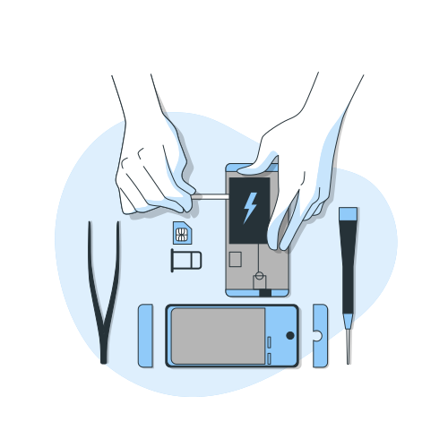


Product Development and Testing
Implementing Marketing Strategies
Partner Outreach

Slide 15



Monitoring and Evaluation
Mass Production
Expansion

Slide 16





OUR TEAM
Bringing one step closer to revolutionizing the way we interact with power outlets
Mihiran
Sanuja
Danidu
Dinuka
Wickramarathne
Rupasinghe
Dabare
Madhushan
Thank You

Slide 17
Viability and Risk Assessment

Slide 18


SWOT Analysis
Opportunities
Threats
Growing Market
Potential Industry Partners
Regulatory Changes
Economic Uncertainity

Slide 19


SWOT Analysis
Strengths
Weaknesses
Innovative Design
Customizability and Flexibility
Technical Expertise
Market Awareness
Supply Chain Dependencies

Slide 20
Scalability and Flexibility

Slide 21
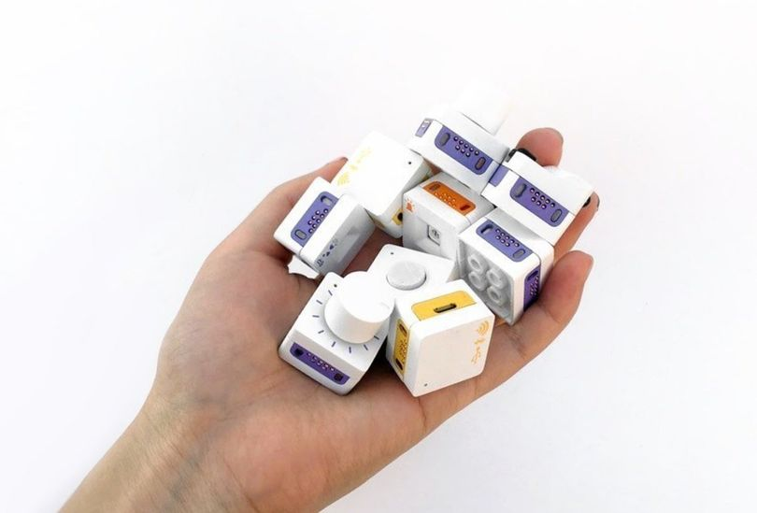


Scalability
Simple Modular Design
Add-on Modules
Expandable Ecosystem

Slide 22




Flexibility
Customizable Configurations
Adaptable to Changing Environments
Mix and Match Modules
Future Proof Technology

Slide 23
Key Performance Indicators (KPIs)
Product Sales Revenue
Customer Acquisition Rate
Module Adoption Rate
Return On Investment
Market Share Growth
Partnership Effectiveness
Product Development Cycle Time

Slide 24

Bluetooth Module
Controls the state of the Power Base using Bluetooth.
Uses a 3rd party application to transmit the signals.
We can develop an application on our own to add more features.

Slide 25

Reprogrammable Timer Module
Uses a timer circuit which we can program using 4 switches.
1s - 999s and 1 - 999 minutes
Different modes in the timer circuit.
Another different module has to be connected to the Power Base in order to use the reprogrammable timer module.

Slide 26

Wireless Module
Controls the state of the Power Base using a wireless remote.
The range of the remote is about 10m.
We can improve the range by designing our own wireless remote by using more powerful components.

Slide 27
Budget - Power Base
Component | Price (Rs.)
74HC74 ic (D flip flop) | 70
5V single-channel Relay module | 75
AC to 5V dc converter | 285
4 ports | 4 x 30
Enclosure | 500
PCB | 140
3 Pins (Male, Female)For take 230 | 80
Other | 130
Totoal | Rs. 1400
Selling Price
Rs. 2000

Slide 28
Budget - Modules
Timer Module
HC06 Bluetooth Module
Component | Price (Rs.)
NE555 ic | 30
PCB | 200
Toggle Switch | 20
Enclosure | 300
Other | 300
Total | Rs. 850
Component | Price (Rs.)
ATmega 328p | 1400
HC-06 Bluetooth Module | 1200
PCB | 200
Enclosure | 300
Others | 300
Total | Rs. 3400
Selling Price Rs. 1200
Selling Price Rs. 3700

Slide 29
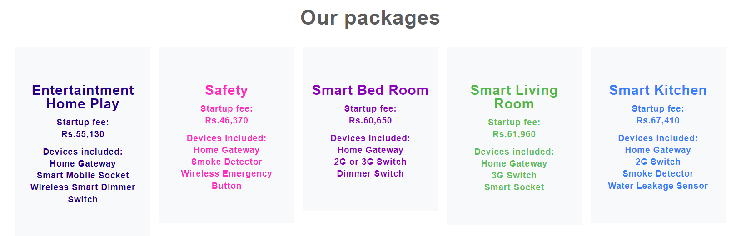
For Example...
A huge white space in
Customization and Flexibility &
Reasonable Pricing

Slide 30

Our Business Plan
Step 2:
Partner up with them

